Slide 1
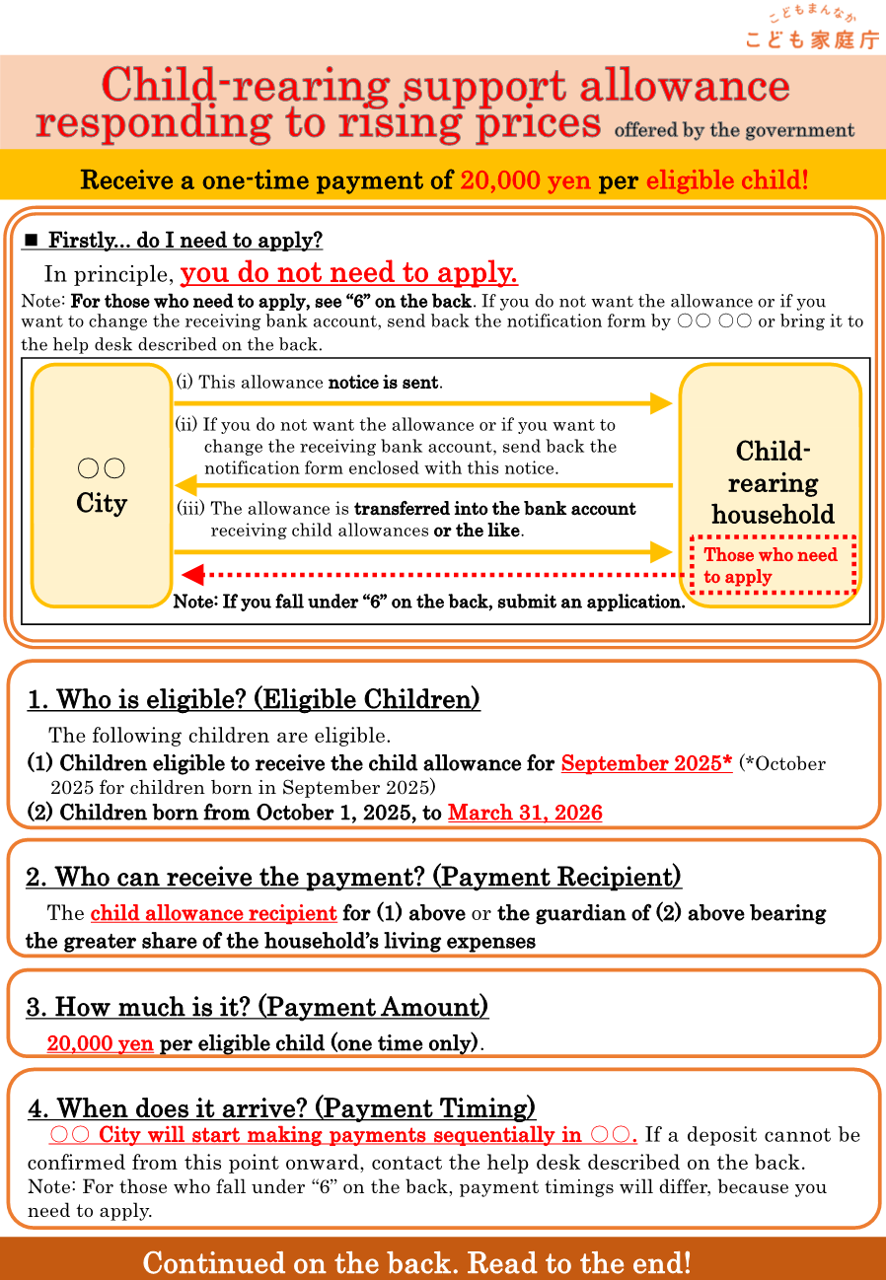
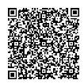
Minowa City
■Introduction—Is it necessary to apply?
In principle, it is not necessary to apply.
Note: Those who need to apply should consult item "6" on the back.
Please check carefully.
Furthermore, only if you do not wish to receive the benefit,
please submit your withdrawal request using the adjacent QR Code.
For those who do not wish
to apply for the benefit, access here↓
Deadline:
February 27, 2026 (friday)
Minowa
In Minowa, payments will begin to be made sequentially starting from mid-March. If a deposit cannot be

Slide 2
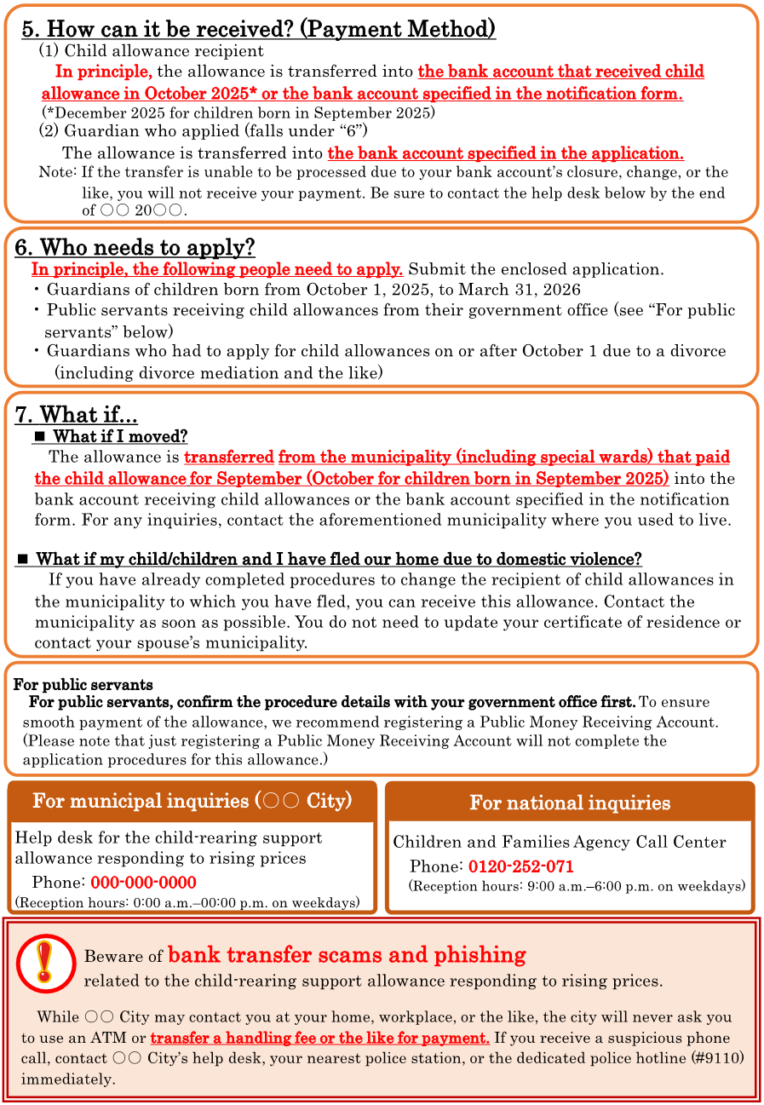
by February 27 (Friday), without fail.
Registration deadline: February 27, 2026 (Friday)
(Minowa City)
0265-79-0007
8:30 a.m.-17:15 p.m. on weekdays
While Minowa City may contact you at ayour home,workplace,or the like,the city will never ask you
Minowa City help desk,your

